Slide 1
Voyageur
A smart trip planner
Paper ID: 170
Cognitive & Machine Intelligence

Slide 2



Problem Definition

Slide 3
Key features
Instant itinerary generation
Considers user’s preferences and builds profile
Considers freeze times for rest, conferences, shopping, etc
Provides alternative options using Genetic algorithm
Save and share plan
Suggests hotels closest to most of the sightseeings
User can specify day start and end time
Suggests restaurants near to user’s location
Places can be swapped between days or can be replaced manually
Places are suggested based on ratings

Slide 4
PROPOSED ARCHITECTURE

Slide 5
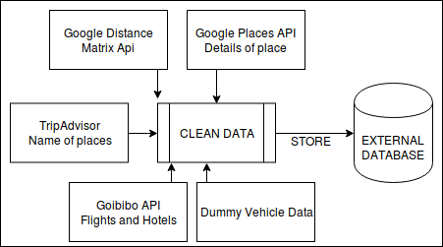
Data gathering and cleaning module

Slide 6
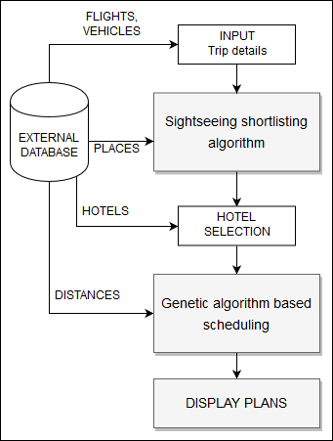
User input module
Preference profile
Source
Destination
Dates
Freeze hours

Slide 7
Sightseeing shortlisting algorithm

Slide 8
Hotel selection module

Slide 9
Genetic algorithm based scheduling

Slide 10
Display plans

Slide 11
Results

Slide 12
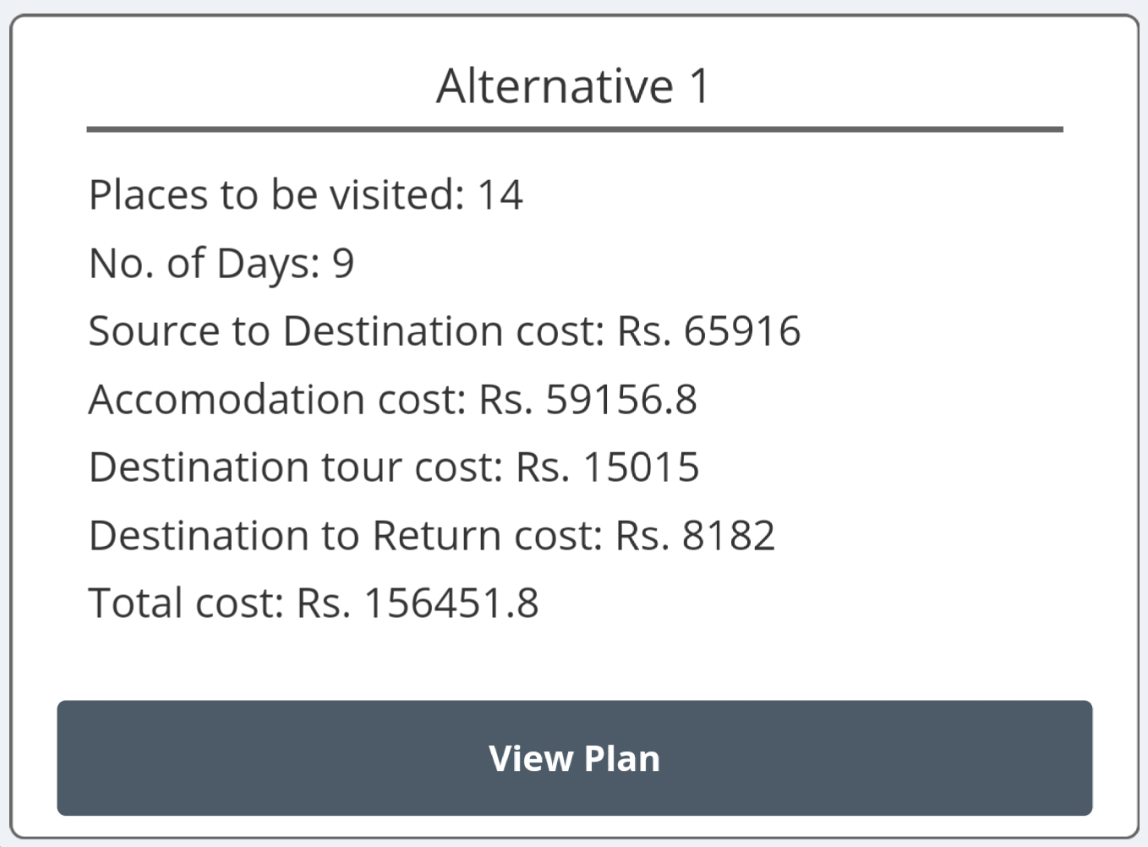
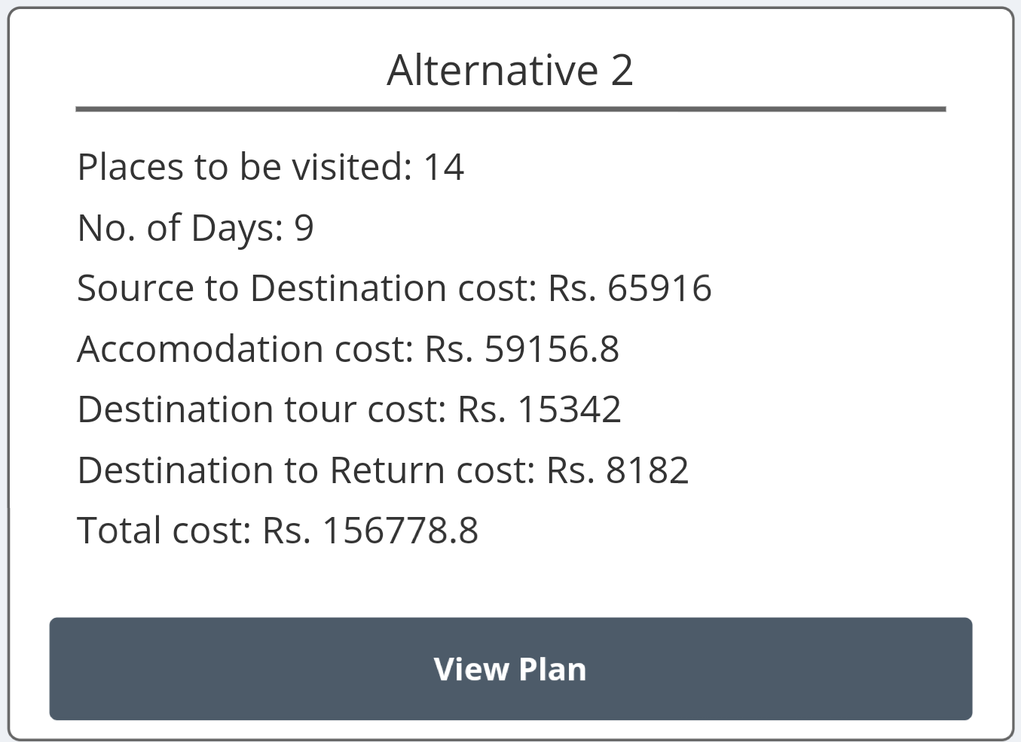

Slide 13
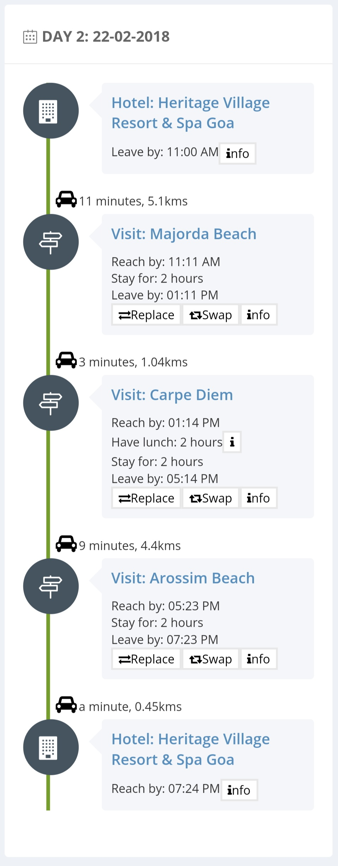
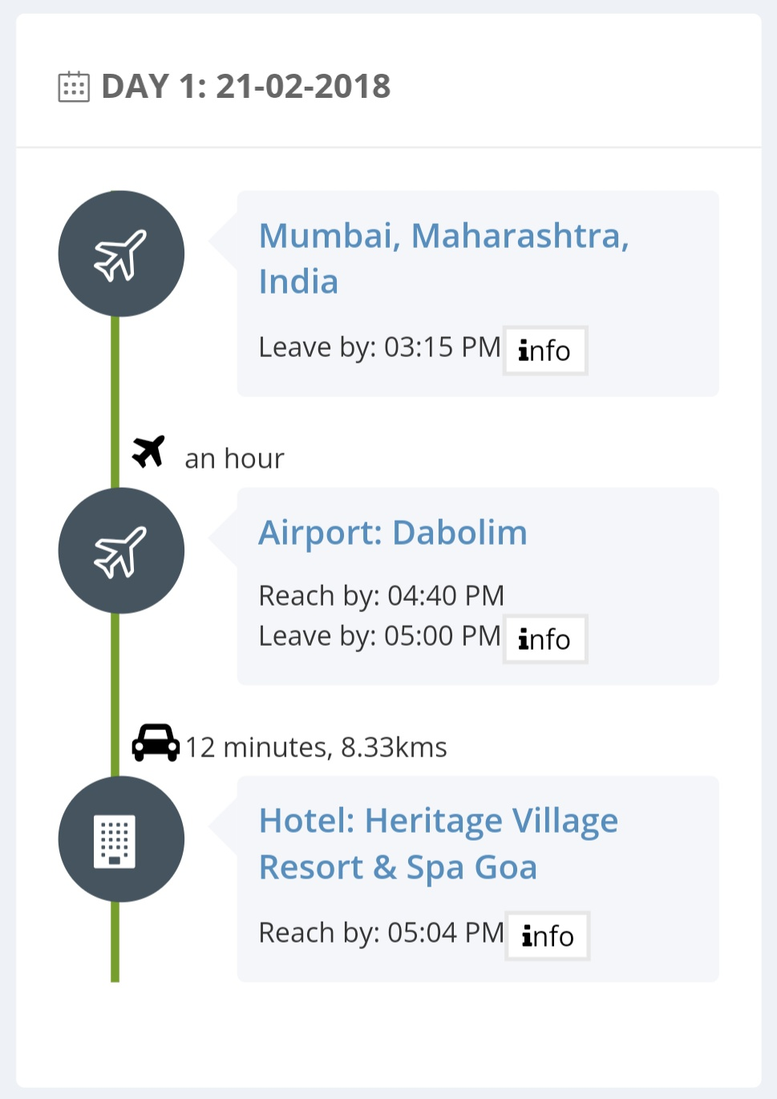

Slide 14
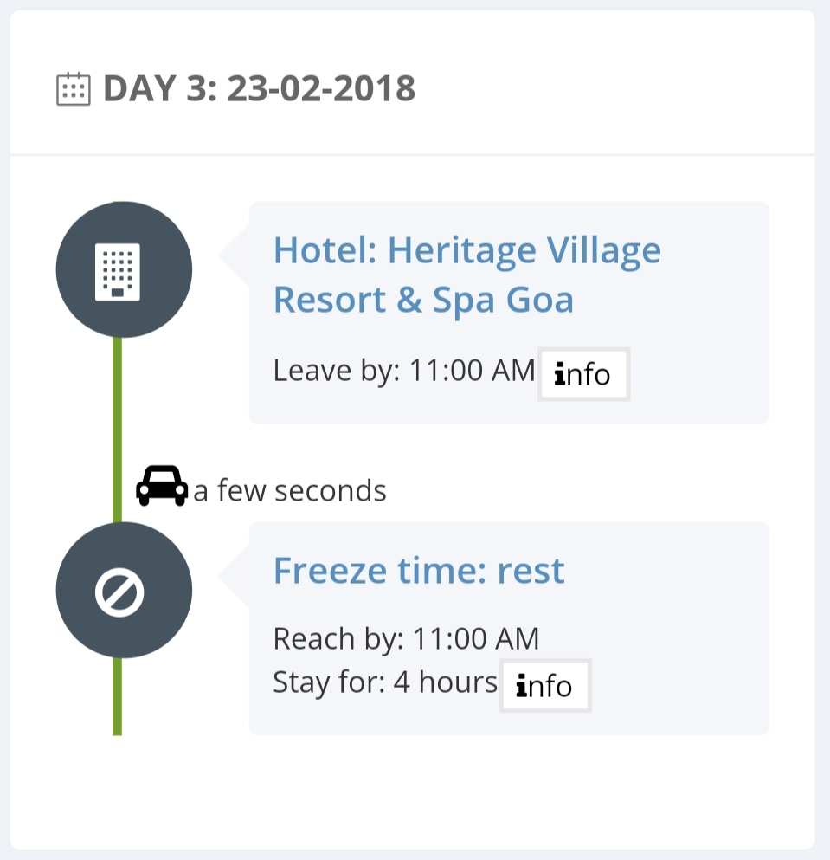
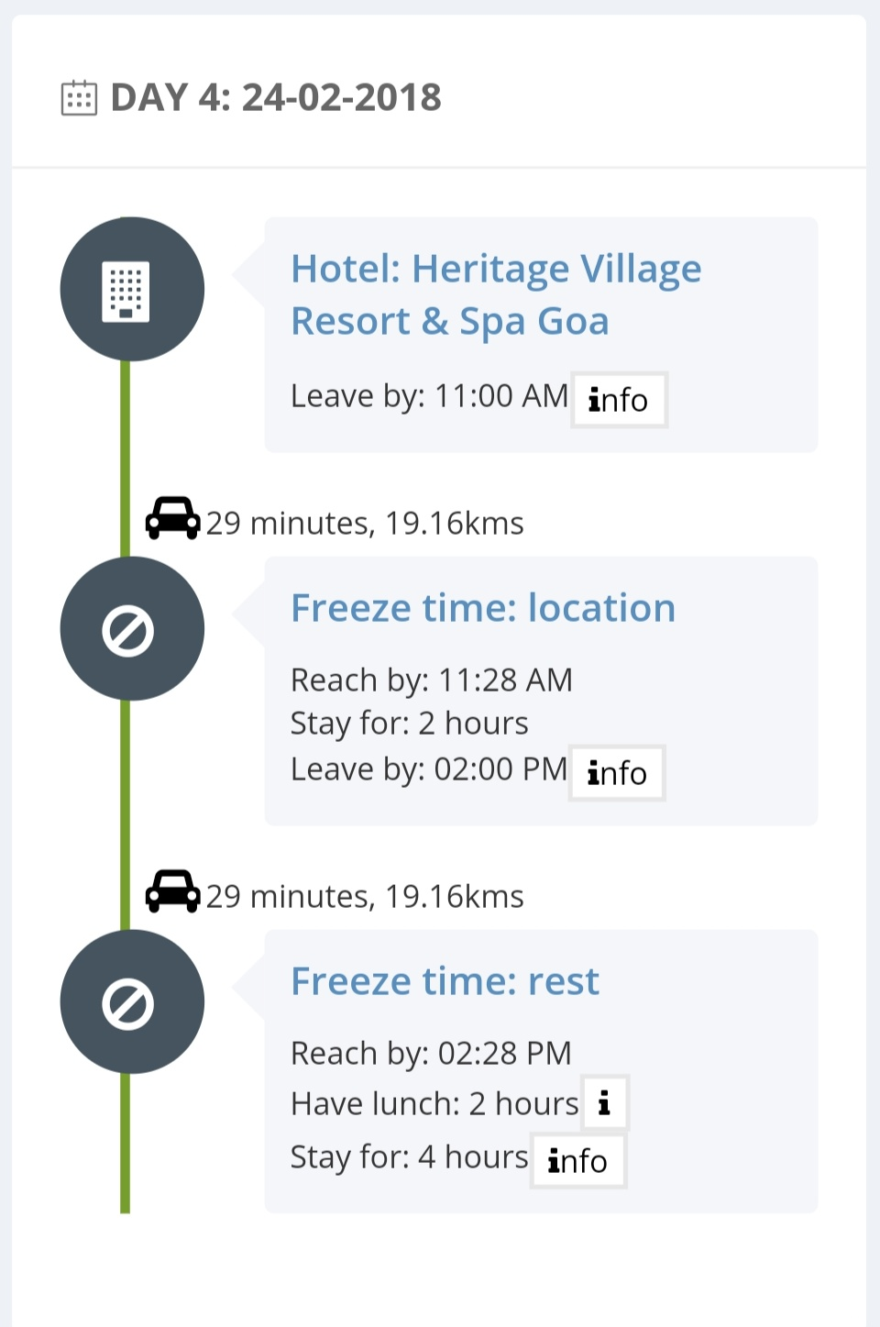

Slide 15
Questions ?

Slide 16
Thank you.

